Slide 1

AWS SAGEMAKER AND SPARK
BASIC AI CONCEPTS & TERMINOLOGIES

Slide 2
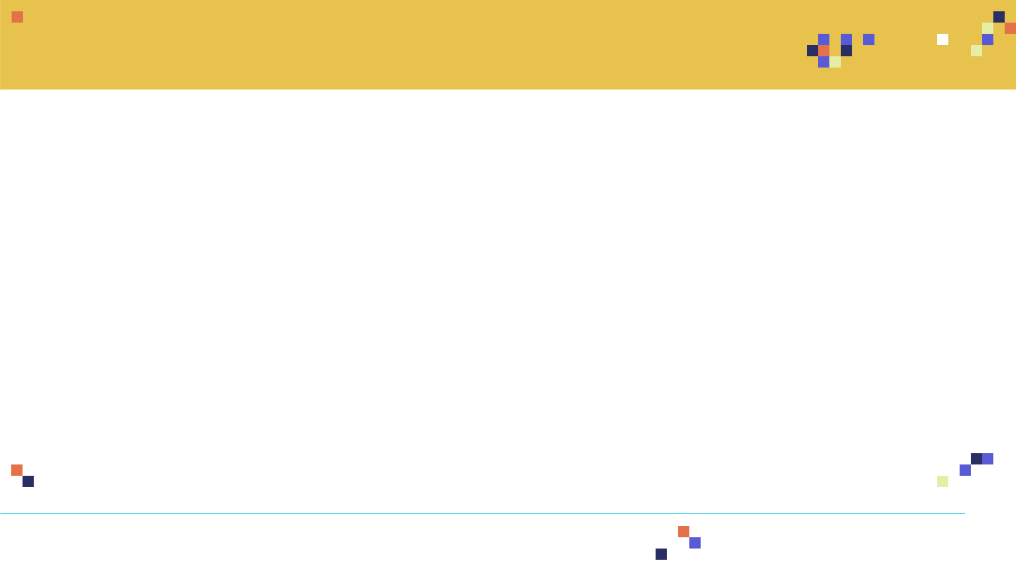
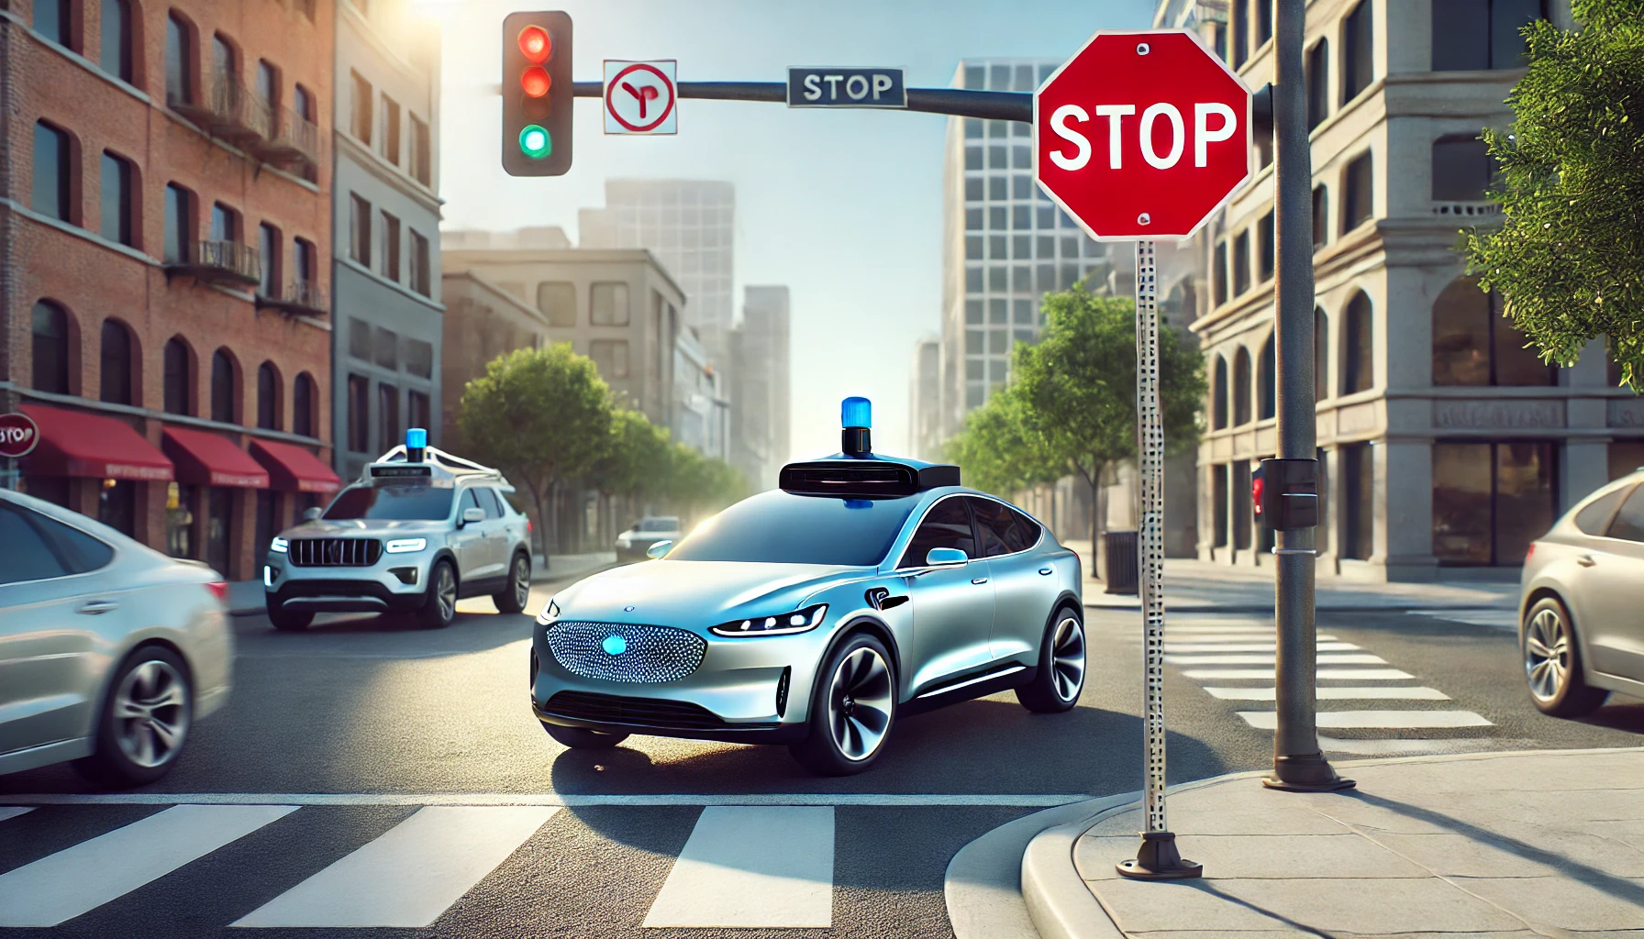

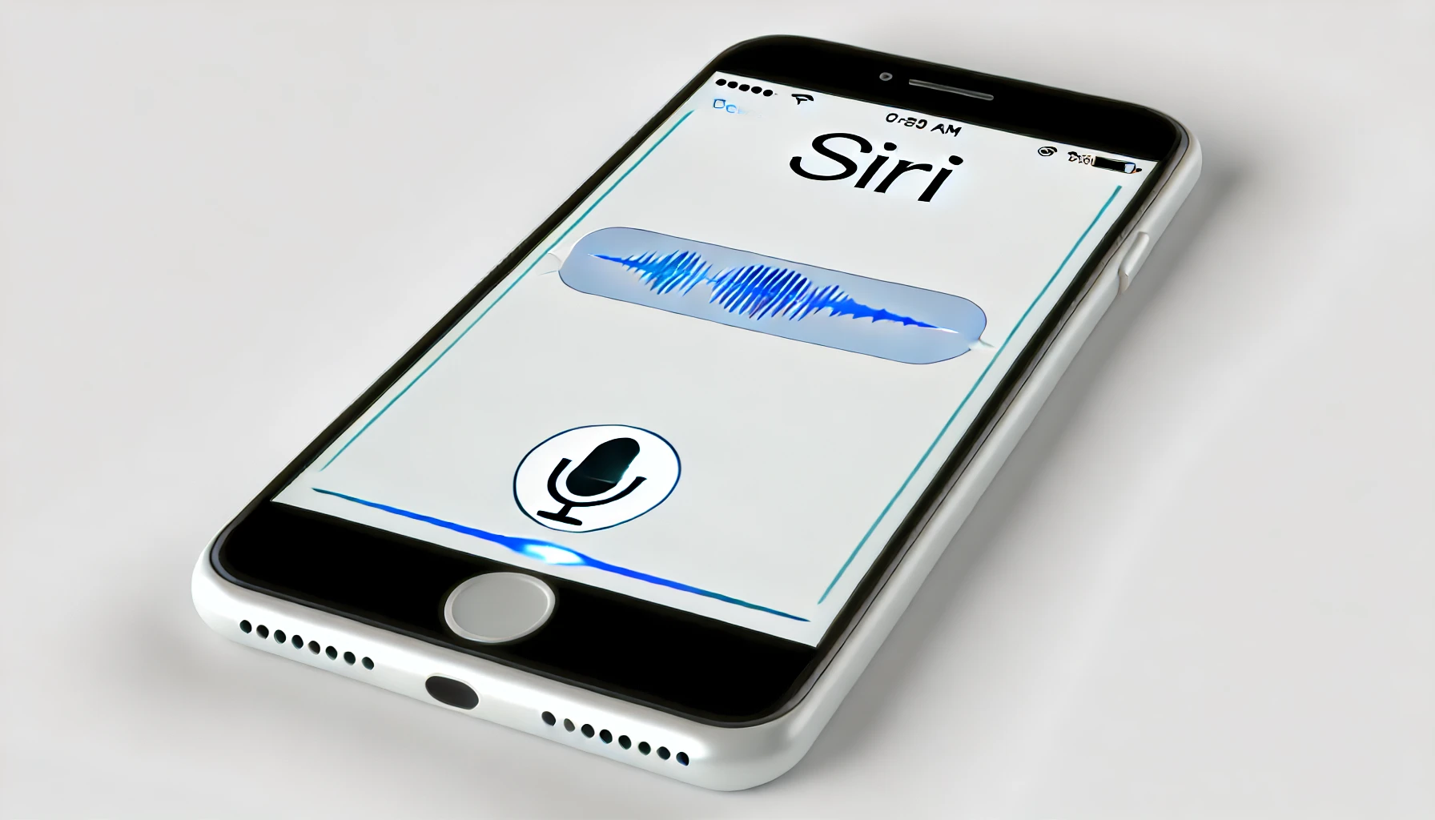
WHAT IS ARTIFICIAL INTELLIGENCE?
Artificial intelligence (AI) is the field of computer science dedicated to solving cognitive problems commonly associated with human intelligence, such as learning, creation, and image recognition.
AI does not only mean robots or Sci-Fi movies! AI applications are everywhere.
AI is a broader field (i.e., the big umbrella) that contains several subfields, such as machine learning, robotics, and computer vision.
Dr. Ryan Ahmed @Stemplicity

Slide 3

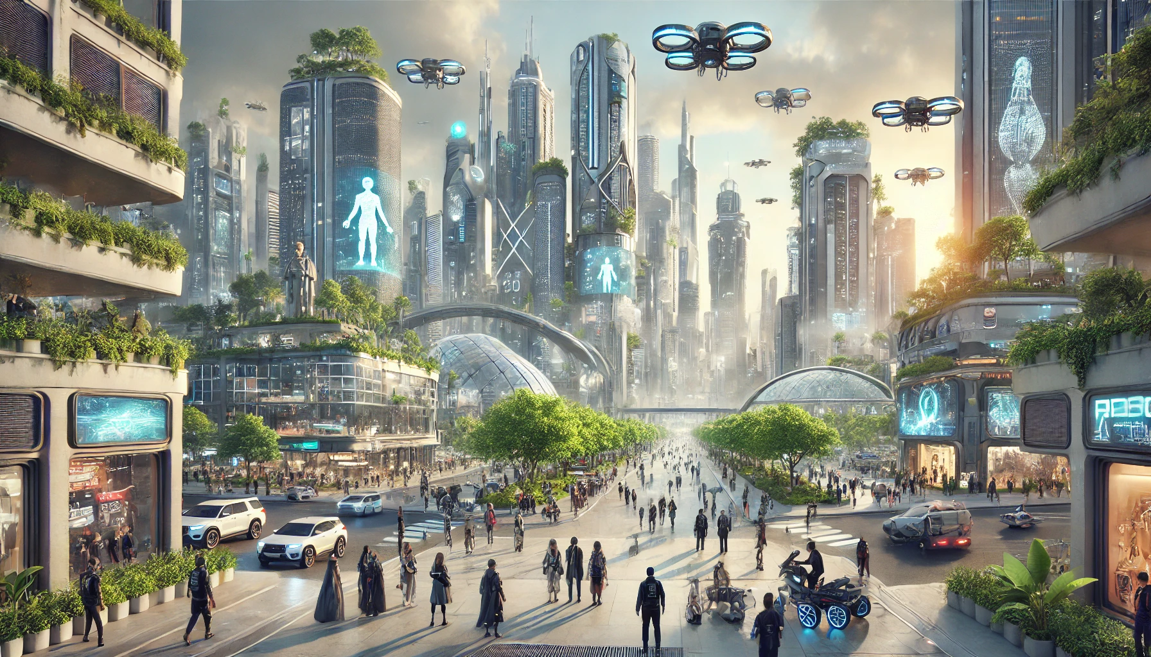
WHAT IS GENERATIVE AI?
Generative AI is a subset of AI that can create new content distinct from the content/data on which it was trained on.
Generative AI models can generate text, images, music, and videos.
ChatGPT is a widely used generative AI large language model developed by OpenAI.
ChatGPT can help you: 1. Answer questions, 2. Generate creative content like poems, code, music, emails, 3. Translate languages, 4. Summarize text, and 5. Brainstorm ideas.
Microsoft invested $1 Billion in OpenAI in 2019 and $10 billion in January 2023.
Model Output:
User Prompt:
Draw an image of the future year 2500
Generative AI model
Dr. Ryan Ahmed @Stemplicity

Slide 4





KEY AI COMPONENTS?
Data: The foundation of AI, as it requires large amounts of data for training.
Algorithms (Models): These mathematical models process data to recognize patterns and make decisions.
Computing Power: High computational resources like GPUs and cloud platforms needed to handle large datasets and run complex algorithms efficiently.
1. DATA
2. ALGORITHMS (MODELS)
3. COMPUTING POWER
Dr. Ryan Ahmed @Stemplicity

Slide 5
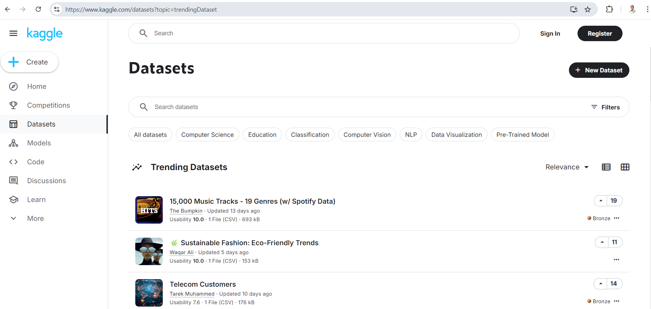

WHERE CAN I FIND DATA?
Data can come from several sources and in various formats, such as images, audio, video, and text.
Data scientists spend around 80% of their time on preparing and managing data for analysis.
https://www.kaggle.com/datasets
https://registry.opendata.aws/registry-open-data/
Dr. Ryan Ahmed @Stemplicity

Slide 6
AI, ML, DL, & GenAI
Artificial intelligence (AI) is a branch of computer science focused on solving problems related to human intelligence, such as learning, creativity, and image recognition.
Artificial Intelligence (AI)
Machine Learning (ML) is a subfield of Artificial Intelligence that enables machines to improve at a given task with experience and without explicit instructions.
Machine Learning (ML)
Deep Learning (DL)
Deep learning (DL) is a subset of machine learning that uses artificial neural networks with many layers to learn from large amounts of data, enabling complex tasks like image and speech recognition.
Generative AI
Generative AI (GenAI) is a type of AI that can create new content distinct from the content/data on which it was trained on.
Dr. Ryan Ahmed @Stemplicity

Slide 7
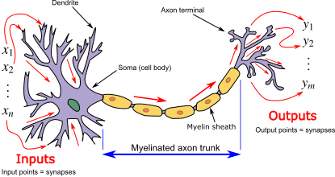
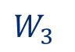
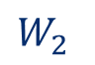

ARTIFICIAL NEURAL NETWORKS
Artificial Neural Networks (ANNs) are computing models inspired by the human brain, consisting of interconnected nodes (neurons) that learn patterns from data to make predictions or decisions.
The human brain has over 100 billion biological neurons that communicate with each other through electrical and chemical signals and help us see, think, and generate ideas.
Biological neurons collect signals from input channels named dendrites, process information in their nucleus, and generate an output to the axon.
Artificial neurons mimic the structure of biological neurons in which neurons are connected by pathways or weights that are adjusted during the training process to map input to output data.
Biological Neuron
Artificial Neuron
X1
$$W_{1}$$
W1
$$W_{2}$$
Activation Function
Inputs
X2
W2
Outputs
$$W_{3}$$
W3
X3
Dr. Ryan Ahmed @Stemplicity
Photo Credit: https://commons.wikimedia.org/wiki/File:Neuron3.png

Slide 8



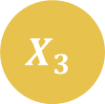


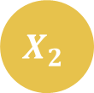

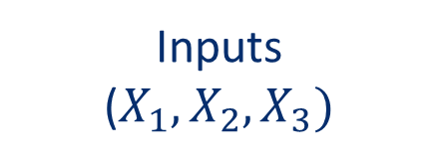

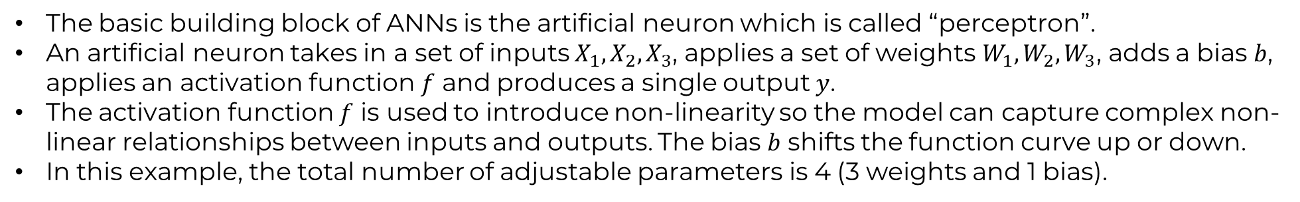

ARTIFICIAL NEURON MATHEMATICAL MODEL
The basic building block of ANNs is the artificial neuron which is called “perceptron”.
An artificial neuron takes in a set of inputs $X_{1}, X_{2}, X_{3}$, applies a set of weights $W_{1}, W_{2}, W_{3}$, adds a bias $b$, applies an activation function $f$ and produces a single output $y$.
The activation function $f$ is used to introduce non-linearity so the model can capture complex non-linear relationships between inputs and outputs. The bias $b$ shifts the function curve up or down.
In this example, the total number of adjustable parameters is 4 (3 weights and 1 bias).
$$b$$
$$X_{1}$$
$$W_{1}$$
$$f$$
Inputs
($X_{1}, X_{2}, X_{3})$
$$W_{2}$$
$$X_{2}$$
Output $y$
$$W_{3}$$
$$X_{3}$$
$$y=f(X_{1}{× W}_{1}+X_{2}× W_{2}+X_{3}× W_{3}+b)$$
Dr. Ryan Ahmed @Stemplicity

Slide 9
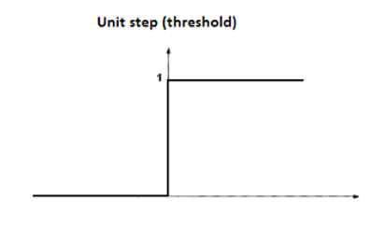
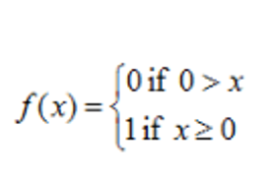
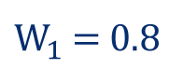
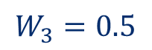
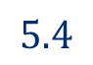
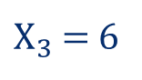

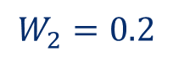
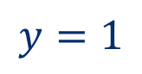
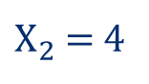
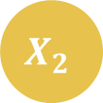

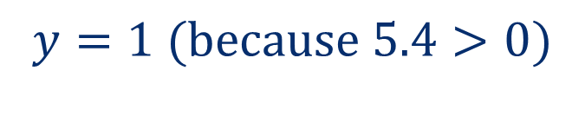
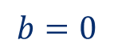
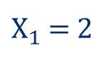
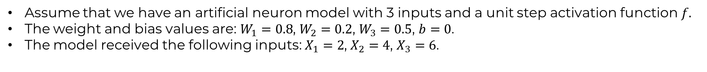

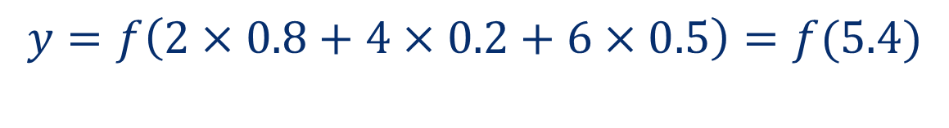
ARTIFICIAL NEURON EXAMPLE
Assume that we have an artificial neuron model with 3 inputs and a unit step activation function $f.$
The weight and bias values are: $W_{1}=0.8$, $W_{2}=0.2$, $W_{3}=0.5$, $b=0$.
The model received the following inputs: $X_{1}=2$, $X_{2}=4$, $X_{3}=6$.
$$y=f\left(X_{1}×W_{1}+X_{2}×W_{2}+X_{3}×W_{3}+b\right)$$
$$y=f\left(2×0.8+4×0.2+6×0.5\right)=f(5.4)$$
$X_{1}$ = 2
$$b=0$$
$$X_{1}$$
$$y=1 (because 5.4>0)$$
$W_{1}$ = 0.8
$$5.4$$
$$f$$
$$y=1$$
$X_{2}$ = 4
$$W_{2}=0.2$$
$$X_{2}$$
$$W_{3}=0.5$$
$X_{3}$ = 6
$$X_{3}$$
Dr. Ryan Ahmed @Stemplicity
Dr. Ryan Ahmed @Stemplicity

Slide 10
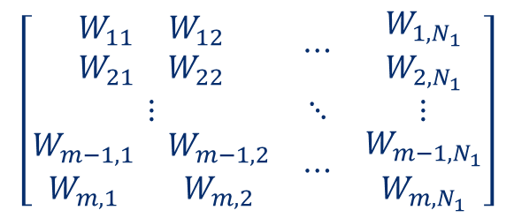
MULTILAYER ARTIFICIAL NEURAL NETWORKS
Multilayer Artificial Neural Networks (ANNs) consist of multiple layers of interconnected neurons.
ANNs consist of an input layer, one or more hidden layers, and an output layer.
The input layer receives the input data, and the output layer produces the final network predictions.
During ANNs training, our goal is to find the optimal values of weights (trainable parameters).
Weights (Trainable Parameters)
Input Layer
Hidden Layer(s)
Output Layer
$$\left[\begin{matrix}\begin{matrix}W_{11} & W_{12} \\ W_{21} & W_{22}\end{matrix} & ⋯ & \begin{matrix}W_{1{, N}_{1}} \\ W_{2{, N}_{1}}\end{matrix} \\ ⋮ & ⋱ & ⋮ \\ \begin{matrix}W_{m−1,1} & W_{m−1,2} \\ W_{m,1} & W_{m,2}\end{matrix} & ⋯ & \begin{matrix}W_{m−1{, N}_{1}} \\ W_{m{, N}_{1}}\end{matrix}\end{matrix}\right]$$
Dr. Ryan Ahmed @Stemplicity

Slide 11
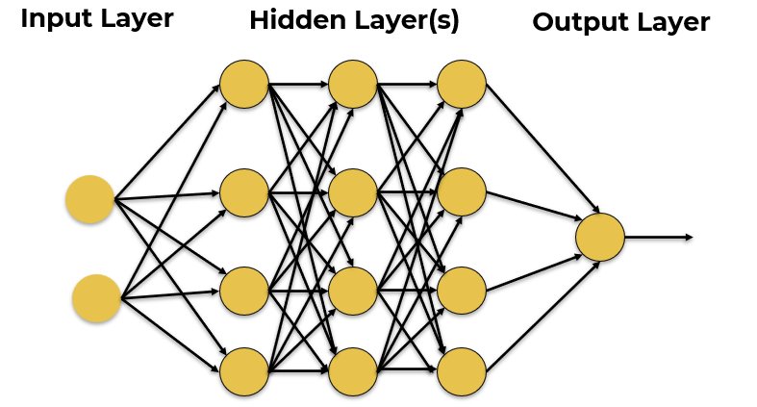
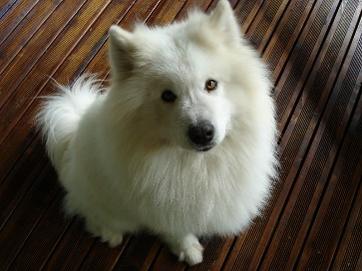



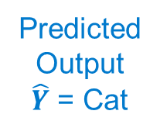
ANNs TRAINING PROCESS
Training Dataset
Input $X$
Predicted
Output
$\hat{Y}$ = Cat
Desired Output $Y$
Label = Dog
Error = $\hat{Y}−Y$
Update Network Weights
Dr. Ryan Ahmed @Stemplicity
Photo Credit: https://commons.wikimedia.org/wiki/File:My_dog.jpg

Slide 12
KEY TERMINOLOGIES
Batch Size: defines the number of training samples that will propagate through the network per batch.
Assume that we have 1000 images available for training. Instead of feeding all images at once to the ANN, which might be computationally expensive, we feed the images in batches.
For batch size = 100, the first 100 images (from index 1 to 100) will be propagated to the network and used for training. Then the next 100 images are propagated (index 101 to 200).
Epoch: one epoch represents a complete pass through all the training samples contained in a dataset.
Learning Rate: refers to the step size at which the neural network model updates its parameters during the training process.
Regularization: a technique used to prevent model overfitting on the training data. Overfitting occurs when a model performs well on the training set and fails to generalize on unseen (new) data.
Activation Function: a mathematical function applied to the output of each neuron in an ANN to allow it to model complex non-linear relationships between inputs and outputs.
Linear
Rectified Linear Unit (ReLU)
Sigmoid
X
X
X
Dr. Ryan Ahmed @Stemplicity

Slide 13

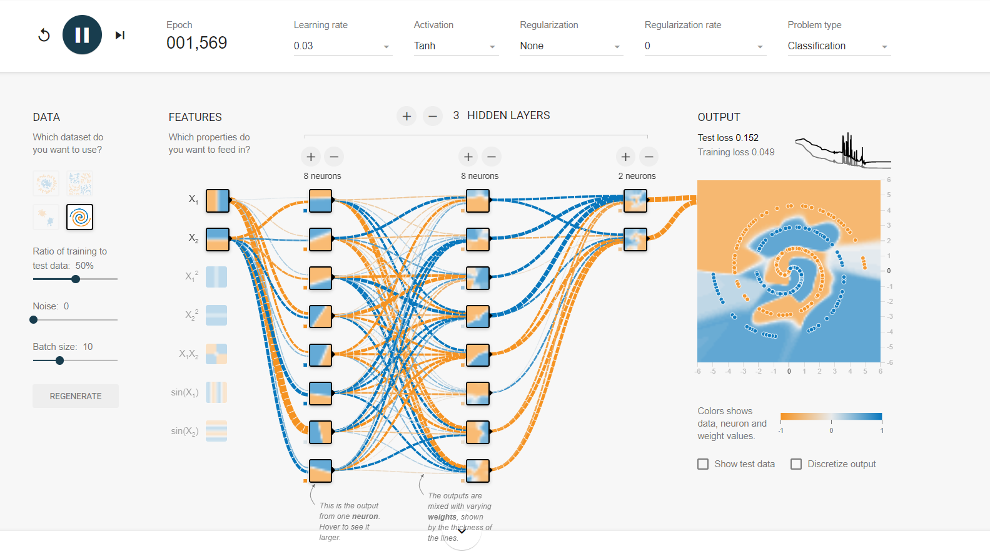
LET’S BUILD NEURAL NETWORKS!
https://playground.tensorflow.org/
Dr. Ryan Ahmed @Stemplicity

Slide 14

COMPUTER VISION
Computer vision is a field of AI that enables computers to understand the visual world.
Computer vision systems can identify, classify, and process objects or scenes using images from cameras and videos in a way that mimics human vision.
Applications: healthcare (medical image analysis), automotive (autonomous driving), security (facial recognition).
Image Recognition
Identifies objects in images, such as recognizing faces & animals.
Object Detection
Locates objects like finding pedestrians for self-driving cars.
Semantic Segmentation
Divides images into segments.
Dog!
Dr. Ryan Ahmed @Stemplicity

Slide 15
THE BIG PICTURE
ARTIFICIAL INTELLIGENCE
Science that enables computers to mimic human intelligence. Subfields: Machine Learning, robotics, and computer vision
MACHINE LEARNING
Subset of AI that enable machines to improve at tasks with experience
SUPERVISED LEARNING
Training algorithms using labeled input/output data.
CLASSIFICATION
REGRESSION
UNSUPERVISED LEARNING
Training algorithms with no labeled data. It attempts at discovering hidden patterns on its own.
CLUSTERING
REINFORCEMENT LEARNING
Algorithm take actions to maximize cumulative reward.
Dr. Ryan Ahmed @Stemplicity

Slide 16
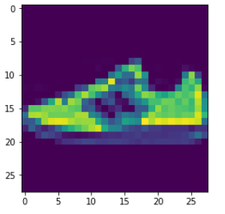
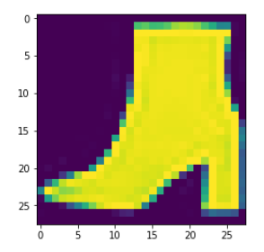
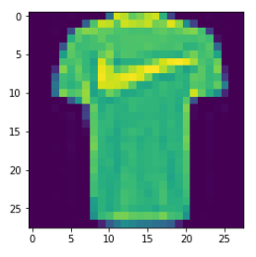
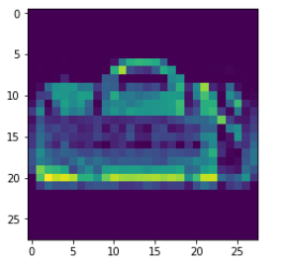
SUPERVISED LEARNING
Supervised learning is used to train algorithms using labeled input and output data.
Performance is assessed by comparing trained model prediction vs. desired output (target labels).
DESIRED OUTPUT
TARGET CLASSES (LABELS)
INPUT DATA
T-SHIRT/TOP
TROUSER
PULLOVER
DRESS
COAT
SANDAL
SHIRT
SNEAKER
BAG
ANKLE BOOT
AI MODEL
Dr. Ryan Ahmed @Stemplicity

Slide 17
UNSUPERVISED LEARNING
Unsupervised learning is a type of machine learning that analyzes data without predefined labels to discover hidden patterns or structures.
In unsupervised learning, the absence of feedback means that the model doesn't receive explicit guidance on whether its outputs are correct or incorrect
DATA CLUSTERS
INPUT DATA
MODEL
Dr. Ryan Ahmed @Stemplicity

Slide 18
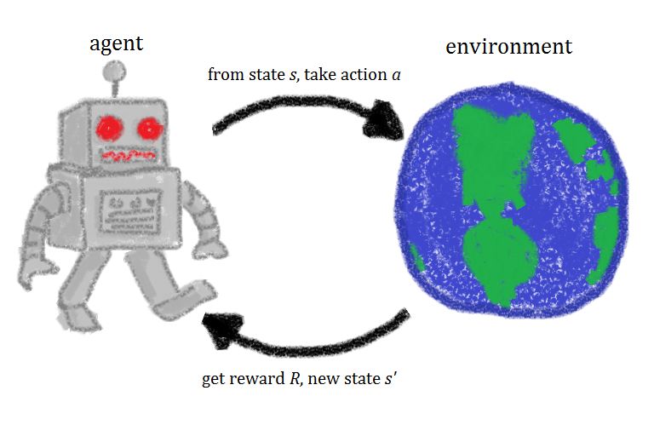



REINFORCEMENT LEARNING
Reinforcement learning allows machines to take actions to maximize cumulative reward.
Reinforcement algorithms learn by trial and error through reward and penalty.
Two elements: environment and learning agent.
The environment rewards the agent for correct actions.
Based on the reward or penalty, the agent improves its environmental knowledge to make better decisions.
ENVIRONMENT
AGENT
-10 Points
+10 Points
Photo Credit: https://commons.wikimedia.org/wiki/File:Rl_agent.png
Dr. Ryan Ahmed @Stemplicity

Slide 19


LABELED Vs. UNLABELED DATA
There are generally two types of data that we could use to train machine learning models.
UNLABELED DATASET
LABELED DATASET
Unlabeled data consists of data that does not have an explanation (class or tag) associated with it.
Labeled data consists of unlabeled data but with a “class” or “tag” associated with it.
LABEL = “CAT”
LABEL = “DOG”
Photo Credit: https://www.pexels.com/photo/grey-and-white-short-fur-cat-104827/
Photo Credit: https://www.pexels.com/photo/portrait-of-a-dog-257540/
Dr. Ryan Ahmed @Stemplicity

Slide 20
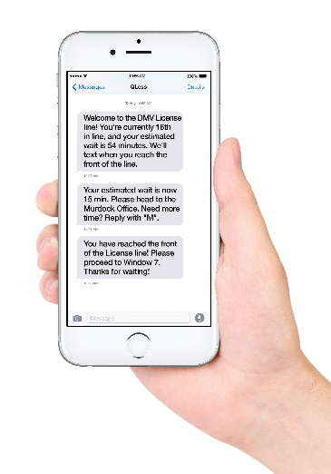




DATA FORMS
Data can come in many forms, such as images, audio, video, and text.
Collecting, structuring, and analyzing this data is critical for companies to gain customer insights and set their marketing and product strategies.
IMAGE/VIDEO
TEXT (CORPUS)
AUDIO/SOUND
TIMESERIES/SIGNALS
Photo Credit: https://pxhere.com/en/photo/1454351
Photo Credit: https://www.flickr.com/photos/29881930@N00/2086641598
Photo Credit: https://commons.wikimedia.org/wiki/File:Mobile_phone_text_messages.jpg
Photo Credit: https://en.wikipedia.org/wiki/File:Messages_Yosemite.svg
Photo Credit: https://www.pexels.com/photo/blue-and-yellow-graph-on-stock-market-monitor-159888/
Dr. Ryan Ahmed @Stemplicity

Slide 21
GOOD Vs. BAD DATA
GOOD DATA
BAD DATA
Many samples (large number of data points)
Not Biased
Does not contain missing data points
Only contains relevant features
Does not contain duplicate samples
Few samples (small number of data points)
Biased
Contains missing data points
Contains irrelevant (useless) features
Contains duplicate samples
Dr. Ryan Ahmed @Stemplicity

Slide 22


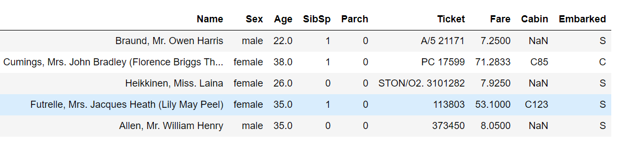
STRUCTURED Vs. UNSTRUCTURED DATA
STRUCTURED
UNSTRUCTURED
Structured data is neat, has a known schema, and could be fit in a fixed field in a table.
Unstructured data has no schema or structure.
Photo Credit: https://pixabay.com/vectors/database-schema-data-tables-schema-1895779/
https://pixabay.com/vectors/newspaper-article-journal-headlines-154444/
https://www.flickr.com/photos/lolololori/2343992441
Dr. Ryan Ahmed @Stemplicity

Slide 23
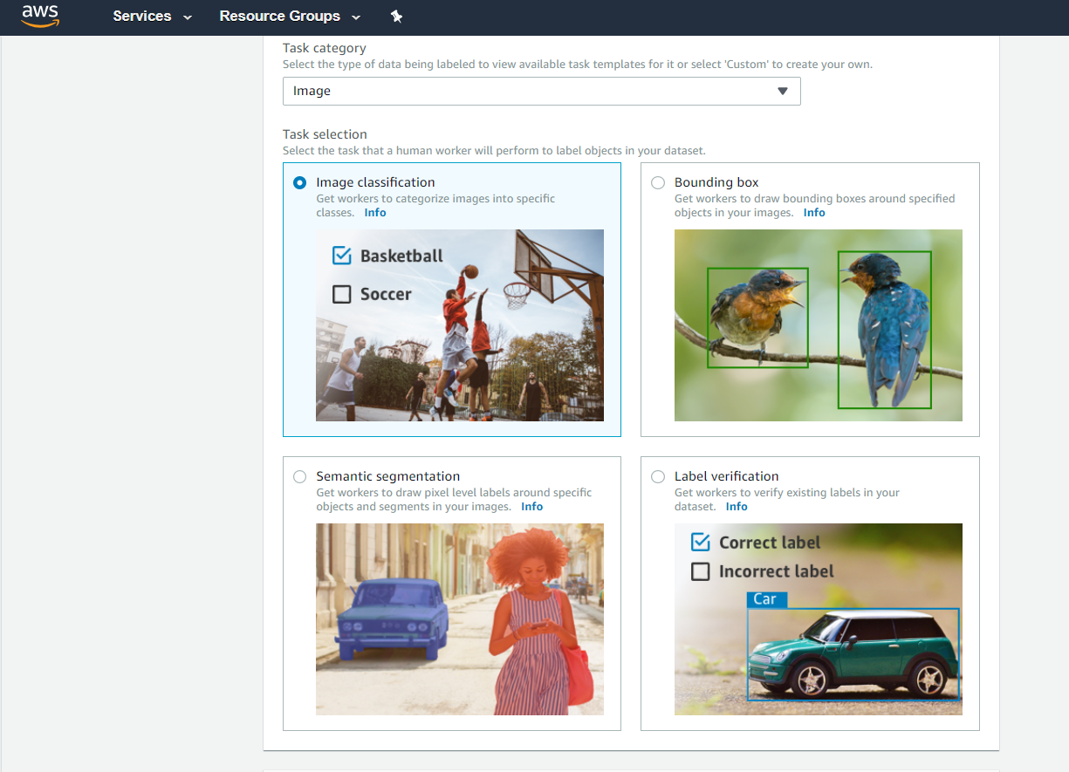

AMAZON SAGEMAKER GROUND TRUTH
Amazon SageMaker Ground Truth: AWS provides this service to assist with labeling data, a critical step in the machine learning workflow.
Ground Truth Definition: In machine learning terminology, "ground truth" refers to the "gold standard" or the accurate reference classification used for training models.
Purpose of Ground Truth: Ground Truth represents the "true" or "actual" labels that you want your model to learn and accurately predict.
AMAZON SAGEMAKER GROUND TRUTH
Dr. Ryan Ahmed @Stemplicity

Slide 24

WHAT IS AWS?
Compute
Storage
Databases
Networking
Analytics
Machine learning & Artificial intelligence
Internet of Things (IoT)
Amazon Web Services (AWS) is the world’s top cloud platform.
AWS offers more than 200 fully featured services.
AWS is adopted by millions of customers globally, including small and large-scale enterprises.
AWS enables companies to be more agile, flexible, and secure at a fraction of the cost.
AWS provides services for various applications, as shown in the chart.
Dr. Ryan Ahmed @Stemplicity

Slide 25

WHAT IS CLOUD COMPUTING?
Cloud computing is the on-demand delivery of services such as compute and storage over the Internet with pay-as-you-go pricing.
Simply put, instead of buying a physical server or a computer, you can lease it!
You can leverage compute power, storage, and databases, on an as-needed basis from a cloud provider like Amazon Web Services (AWS).
Photo Credit: https://pixabay.com/illustrations/cloud-computing-cloud-system-cloud-2153286/
Dr. Ryan Ahmed @Stemplicity

Slide 26
WHAT ARE THE BENEFITS OF CLOUD COMPUTING?
AGILITY
Cloud computing empowers companies to be agile and experiment with new ideas faster/cheaper.
ELASTICITY
Cloud computing allows for scaling and shrinking resources based on demand.
COST SAVINGS
Cloud computing trades capital expenses such as buying physical servers for variable expenses.
DEPLOY GLOBALLY IN MINUTES
AWS infrastructure is available globally and companies can deploy services anywhere in minutes.
Instead of buying physical hardware/software and setting them up which might take months, cloud computing gives companies access to compute/storage/ML that enables faster innovation.
In minutes, companies can provision and deploy resources such as compute, storage, and databases.
No need to over-provision resources up front.
Massive savings with economies of scale.
Placing applications near the customer is critical to improve latency and performance.
Dr. Ryan Ahmed @Stemplicity

